Slide 1
Paper title
Motivation & Problem Formulation
What is the high-level problem?
Why is it important?
What are the challenges?
What is missing from previous works?
What are the key assumptions?
Method
What they propose to solve the problem?
Why this works?
Algorithm, architecture, solution
Results
How they evaluation their method? Dataset, baselines, metric, etc
What are the key improvements & takeaways
Pros and Cons (Your thoughts)
Pros: why you think this paper could get in?
Cons: unrealistic assumptions, missing elements, missing experiments, etc.

Slide 2
Reading Group
4/21

Slide 3
SpeechQoE: A Novel Personalized QoE Assessment Model for Voice Services via Speech Sensing (SenSys 2022) (link)
Motivation & Problem Formulation
During pandemic, there is increasing need for audio/video communication.
It is important for the companies to know: is user satisfactory with the Quality of Experience (QoE)?
Existing works:
parametric models: QoE ~ QoS
One-for-all evaluation metrics
The author argues that:
Human factors (mood, expectation)
Contextual factors (background noise)
Personalization
Key question to address: personalized QoE assessment model

Slide 4
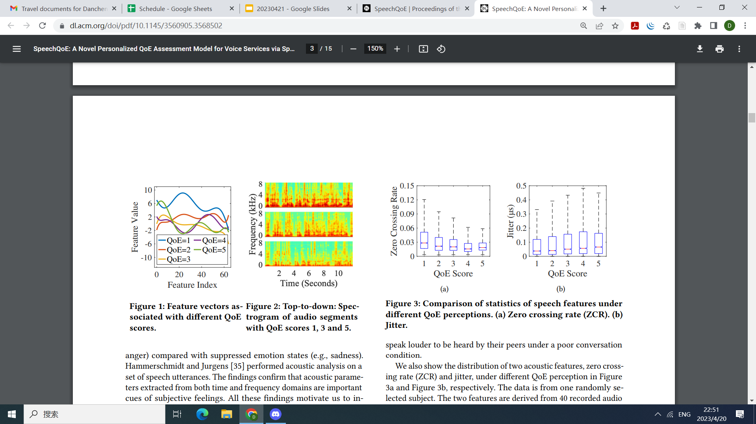
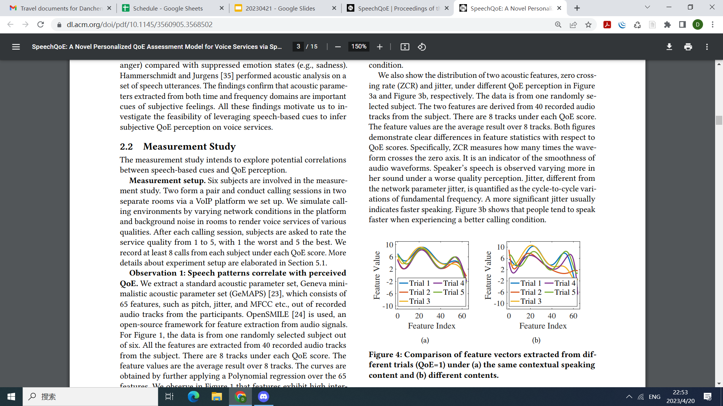
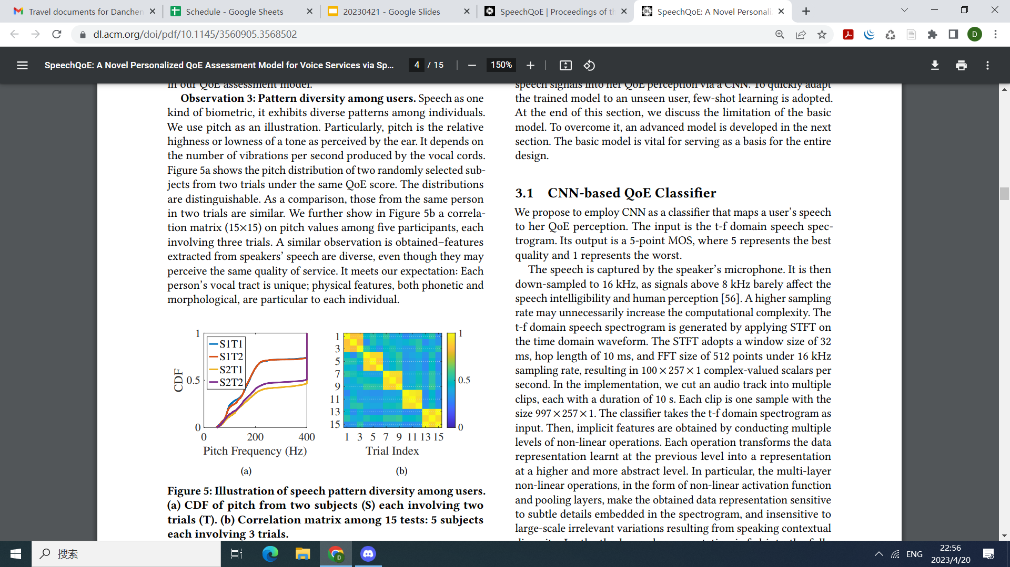
SpeechQoE: A Novel Personalized QoE Assessment Model for Voice Services via Speech Sensing (SenSys 2022) (link)
Motivation for method and contributions
Inspired from neurophysiology: “a speaker’s speech can reflect her subjective feelings”
Use speech sensing to predict personalized QoE
Claimed contributions:
Investigate the relationship between QoE and speech signals
Propose personalized QoE assessment model using speech-based features
Enhance few-shot learning with data synthesis
Present a new dataset on this area
Notes:
Speech features for different QoE levels (1 worst 5 best) are significantly different, fig4: speech-QoE relationship is consistent, fig5: speech features for different users are different

Slide 5
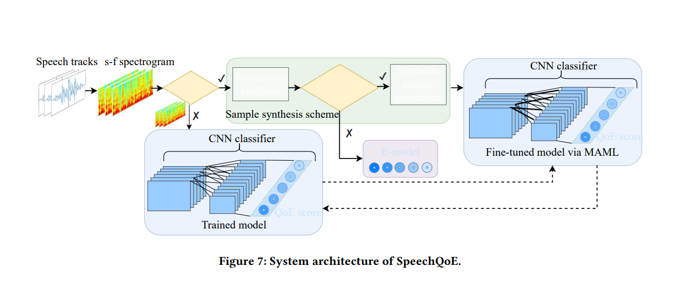
SpeechQoE: A Novel Personalized QoE Assessment Model for Voice Services via Speech Sensing (SenSys 2022) (link)
STFT
Model details not specified
Notes:
Ugly picture!!!!

Slide 6
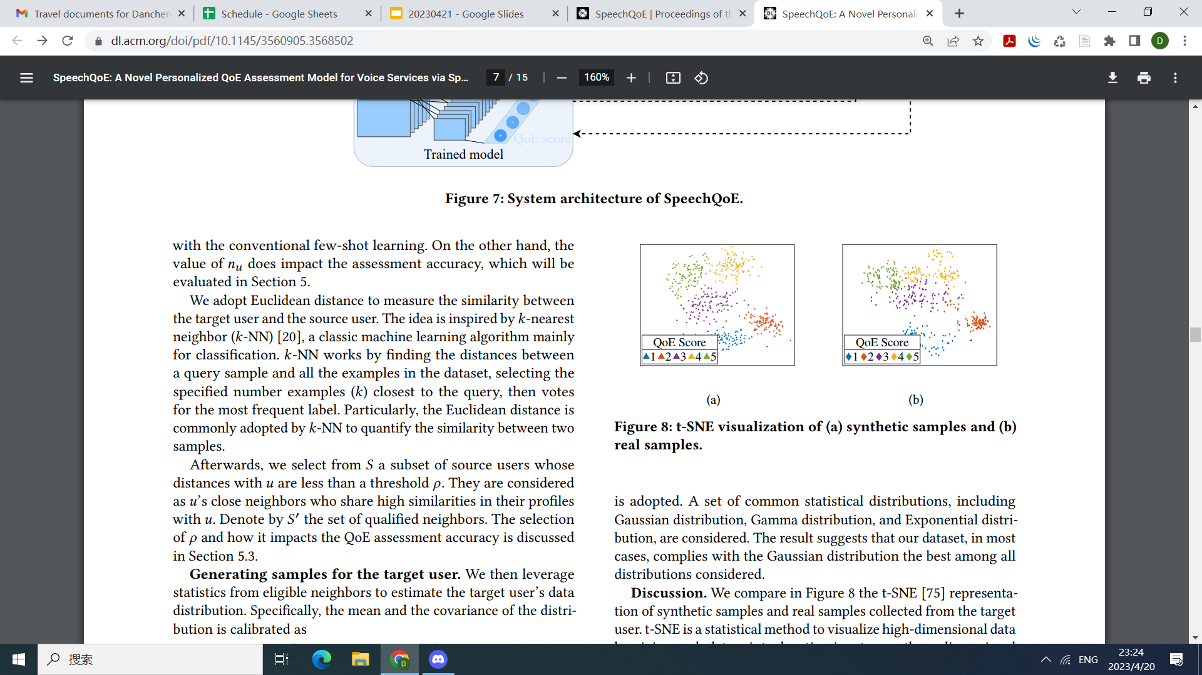
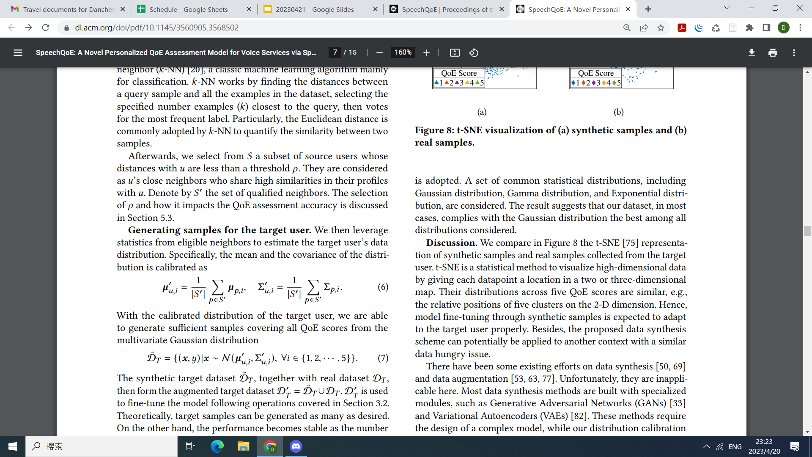
SpeechQoE: A Novel Personalized QoE Assessment Model for Voice Services via Speech Sensing (SenSys 2022) (link)
Enhance few-shot learning with data synthesis
Ideally, each user should have their own CNN model
Use MAML for unseen users
K samples from each class (when K=3, 15 samples)
Big overhead especially when low scores are less frequent
Enhancement to MAML on this task:
Generate synthetic data in unbalanced classes
Each user has a profile that is represented as a Gaussian distribution for each QoE level
After obtaining a few (3-5) samples from the new user, find the closest neighbors for this new distribution from the existing user profiles, and:
In the case there are not enough neighbors, parametric model serves as a backup.
Notes:
Speech features for different QoE levels (1 worst 5 best) are significantly different, fig4: speech-QoE relationship is consistent, fig5: speech features for different users are different

Slide 7
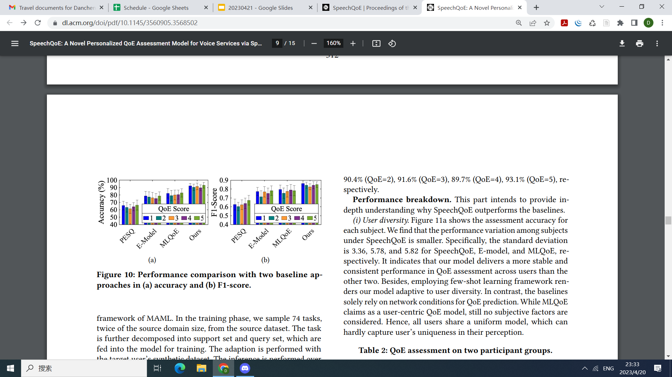
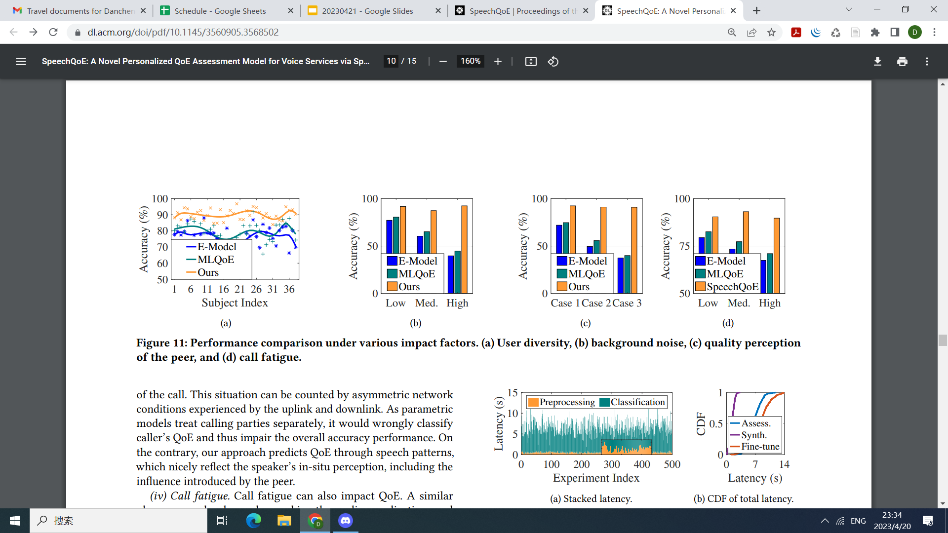
SpeechQoE: A Novel Personalized QoE Assessment Model for Voice Services via Speech Sensing (SenSys 2022) (link)
Results
Real person experiments: 38 recruited subjects, two per group, 200 calling sessions
QoS controlled by experimenter.
Baselines:
PESQ [2001]: speech quality approach
MLQoE[2016]: map QoS to QoE
E-model[2005]: analytical parametric model

Slide 8
SpeechQoE: A Novel Personalized QoE Assessment Model for Voice Services via Speech Sensing (SenSys 2022) (link)
Pros
Very well-written motivation, tells a great story
The synthetic data generation for MAML with unbalanced dataset is noteworthy
Might be useful for some of our work?
Cons:
Baseline outdated, lack details on model/architecture, which makes the paper unconvincing
Really ugly figure for the architecture, obvious mistake on the figure
Seems a little off topic from the conference…

Slide 9
Neurally-Inspired Hyperdimensional Classification for Efficient and Robust Biosignal Processing
Ivannia
ICCAD 2022
Motivation & Problem Formulation
Biosignals consist of several sensors that collect information time series.
Time Series = Temporal Dependencies which are difficult to process
Previous Works:
Deep Learning Algorithms:
Extract patterns or insight
Difficult & Inefficient to train -> large training memory + Many iterations
HDC:
High- efficiency + Noise-tolerant computations + Few iterations
Low classification accuracy due to linear hyperdimensional representation
Real-time support is lacking due to costly & non-hardware friendly operations
Not good with partially labeled data
Assumptions:
Low sampling data
Embedded systems

Slide 10
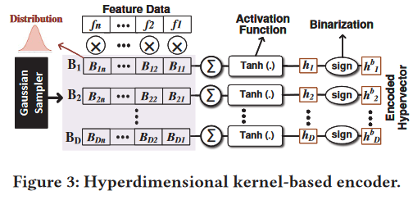
Neurally-Inspired Hyperdimensional Classification for Efficient and Robust Biosignal Processing
Ivannia
ICCAD 2022
Method
TempHD: Accurate + Efficient Biosignal Classification
Non-linear Hyperdimensional Encoding -> considers non-linear interactions
Kernel Based Encoding based on the Kernel Trick
F = Input vector
B = Random hvs
Dot product
Activation function (Tan)
Binarization

Slide 11
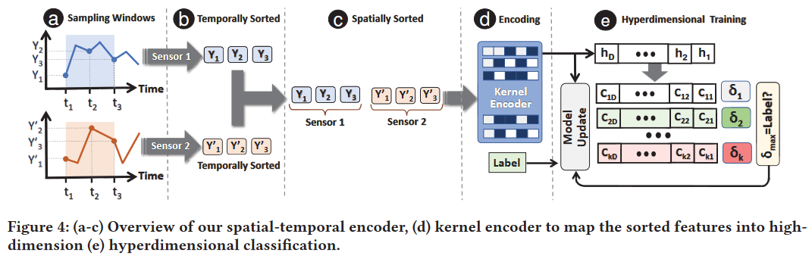
Neurally-Inspired Hyperdimensional Classification for Efficient and Robust Biosignal Processing
Ivannia
ICCAD 2022
Method
TempHD: Accurate + Efficient Biosignal Classification
Preserves spatial-temporal information
Spatial correlation with past encoding
Objective = Represent pattern of samples as high-dimensional pattern
Temporally sort them -> Sort them by sensor
Each row of the kernel encoder is a projection vector that adds up spatial temporal information of all the sensors in different weights.

Slide 12
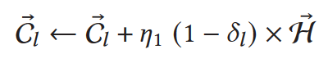
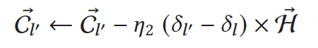
Neurally-Inspired Hyperdimensional Classification for Efficient and Robust Biosignal Processing
Ivannia
ICCAD 2022
Method
TempHD: Accurate + Efficient Biosignal Classification
Adaptively update to eliminate saturation: Takes into account how much information is the new hv going to bring before adding it to the class hv.
Correct
Incorrect

Slide 13
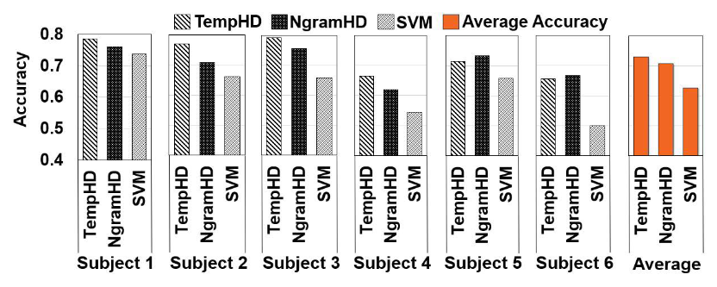
Neurally-Inspired Hyperdimensional Classification for Efficient and Robust Biosignal Processing
Ivannia
ICCAD 2022
Results
Dataset: Noisy EEG data for brain-machine interface
Baselines: SVM, State of the art HD ( NgramHD)
Architecture: CPU platform with AMD Ryzen-5 3600X
Metric:
Accuracy
Efficiency = Runtime
Accuracy
On average 3% higher than NgramHD
Varies between individuals

Slide 14
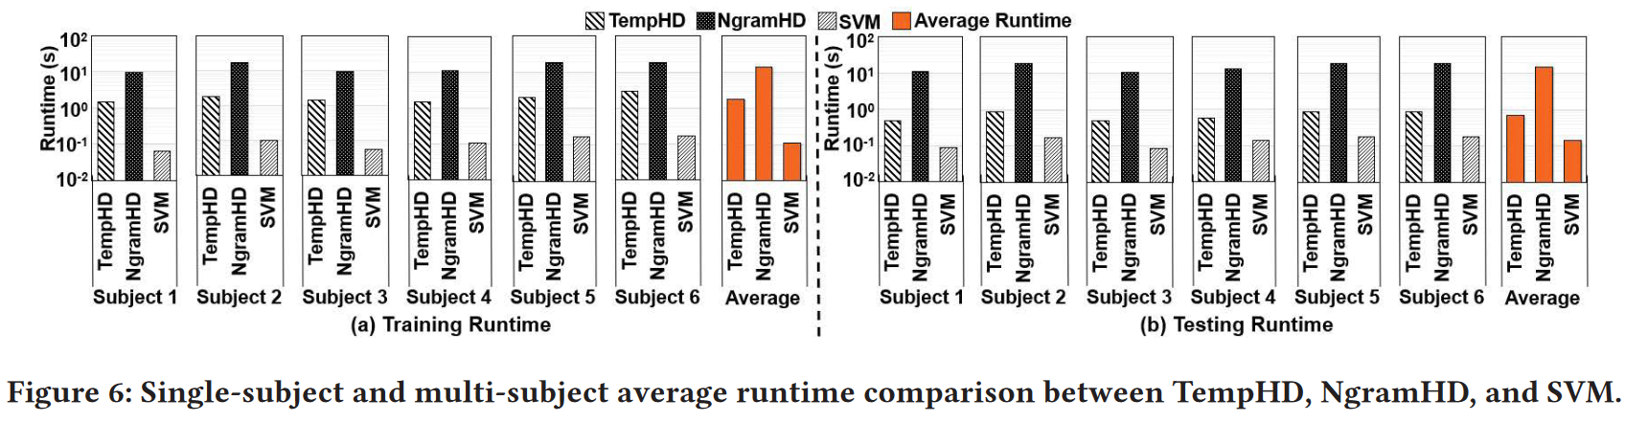
Neurally-Inspired Hyperdimensional Classification for Efficient and Robust Biosignal Processing
Ivannia
ICCAD 2022
Results
Efficiency
SVM achieves fastest training and testing because of low training samples
SVM’s runtime rapidly increases as dataset gets larger

Slide 15
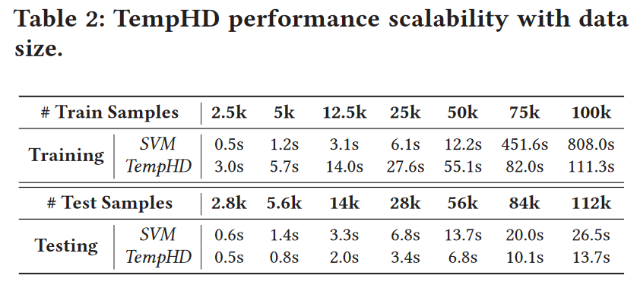
Neurally-Inspired Hyperdimensional Classification for Efficient and Robust Biosignal Processing
Ivannia
ICCAD 2022
Results
Efficiency
SVM achieves fastest training and testing because of low training samples
SVM’s runtime rapidly increases as dataset gets larger

Slide 16
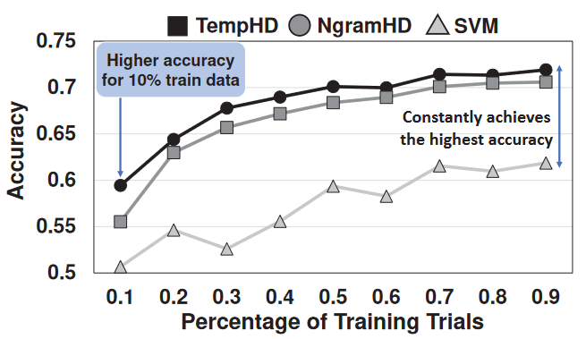
Neurally-Inspired Hyperdimensional Classification for Efficient and Robust Biosignal Processing
Ivannia
ICCAD 2022
Results
Partial training data
Nearly 60% accuracy with only 10% of the training samples

Slide 17
Neurally-Inspired Hyperdimensional Classification for Efficient and Robust Biosignal Processing
Ivannia
ICCAD 2022
Pros and Cons
Pros: Really thorough with their experiments
Not only metrics explained in contributions:
Dimensionality
Percentage of training trials
Execution Breakdown
Accuracy
Runtime
Scaling
Cons: Different assumptions as to why TempHD works best

Slide 18
MULTIMODAL FEDERATED LEARNING VIA CONTRASTIVE REPRESENTATION ENSEMBLE
Eric
[ICLR’23]
Motivation
FL on multimodal data is not sufficiently studied
There are benefits of leveraging system heterogeneity.
Challenges
Data heterogeneity (uni-modal, multimodal clients)
Task heterogeneity (Model trained for different task)
Model heterogeneity (DIfferent model architecture)
Past works
KD in FL: Not centralized
FedGKT: No client selection, hard to reach consensus
Task limitation (Uniform task across client), exchange logit weights.
Many previous work are unable to handle multimodality.

Slide 19
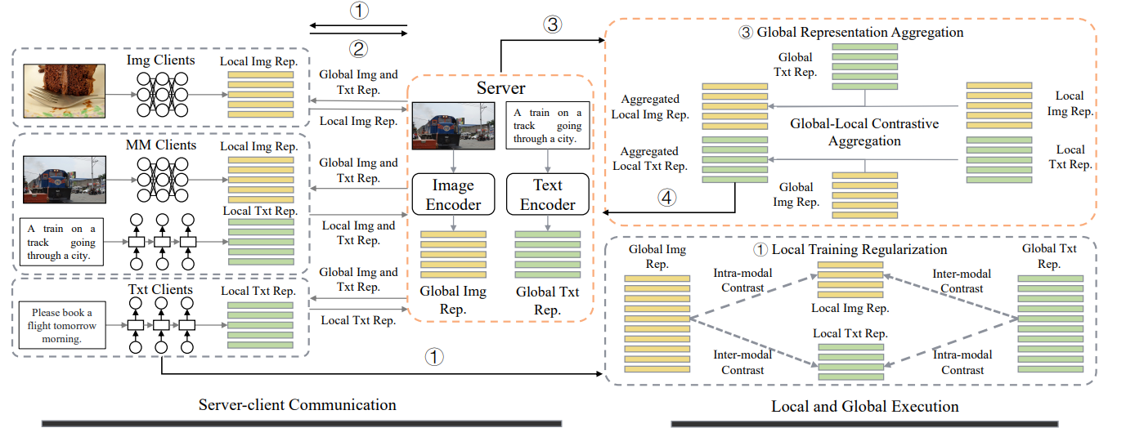
Problem Formulation / System overview
Eric
Three types of clients Image, text, both
Have access to a public multimodal dataset
No assumption on: architecture, task.
Knowledge transfer by representation, not logits / weights

Slide 20
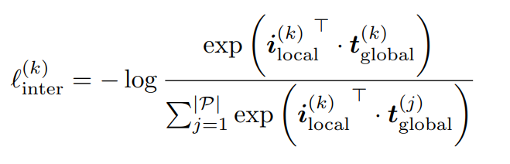
Method: Local inter-modal contrast
Eric
Modality Gap: uni-modal clients are unaware of existence of other modalities.
Train / Aggregate directly led to model drift.
Lead to unimodal/multimodal client produce different representation for the same modality.
Goal: Complementing missing-modality information
How: global representation guild local training.
Force learning towards shared multimodal representation space
Contrasting with unrelated pairs in public set

Slide 21
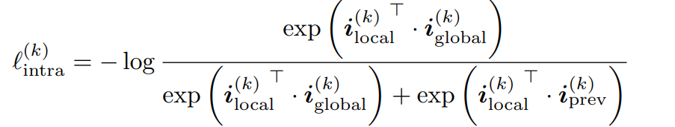
Method: Local intra-modal contrast
Eric
Task gap: Model trained with different task (image classification/ image-text retrieval) have different optimization target.
Lead to client with different task produce different representation for the same modality.
Goal: Regularize local representations towards their global consensus, even when task is different.
How: Global representation as anchor point in learning representation.
Matching global consensus
??

Slide 22
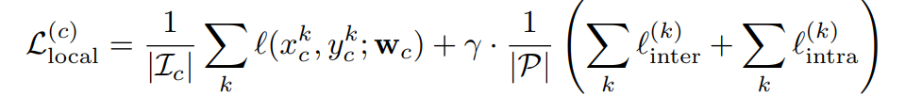
Method: Composite Loss
Eric
Assume the global multimodal server has partially learned a shared representation.
Local data training loss
Regularization
By matching global representation
Introduce suitable similarity between local models
Clients w/ heterogeneous modality will not interfere
Clients w/ heterogeneous task will not interfere
Learning conforming composite loss = Learning multimodal knowledge that can apply together.

Slide 23
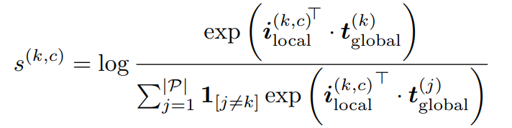
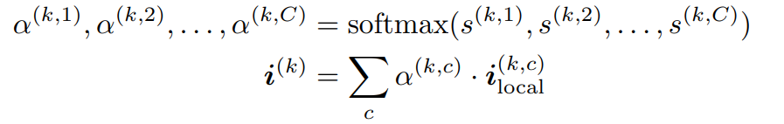
Method: Contrastive aggregation
Eric
Aggregating representation for knowledge distillation
Intuition: Local rep close to its pair in server rep and far from other pairs better captures the semantic information and cross-modal interaction of data.
Weighted sum of client rep of public data.

Slide 24
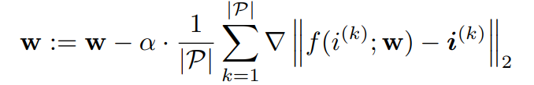
Method Server model update
Eric
By knowledge distillation
Match aggregated representation.
Learn a representation where different class of data are better separated.

Slide 25
Eval
Eric
Dataset:
Multimodal - MS-COCO (Text-image pair)
Nuimodal - Flicker30K(text) CIfar(Image)
Public: 50000 sample form MS-COCO
Baselines
FedAvg FedIoT FedMD FedET FedGEMS

Slide 26
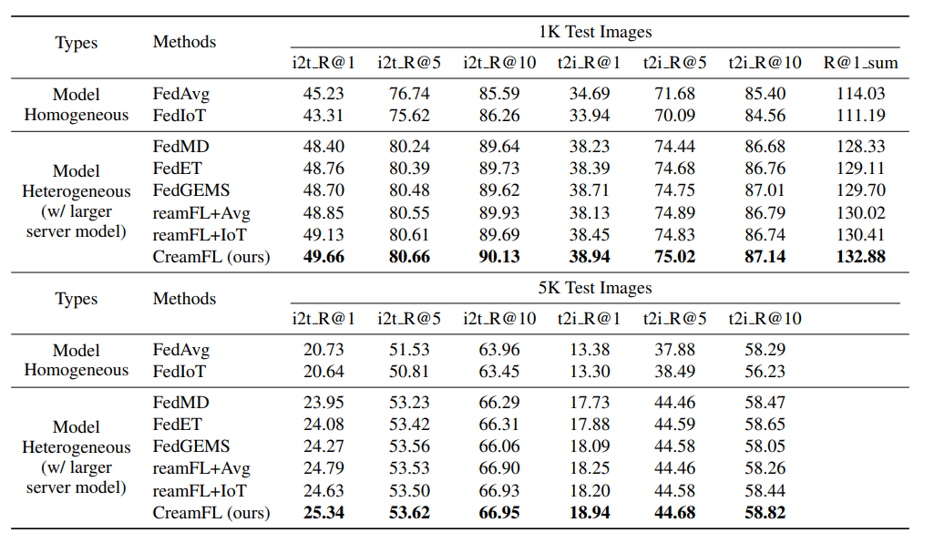
Main Results
Eric

Slide 27
Pro / Con
Eric
Pros
Very very interesting idea with little assumption.
Achieve FL knowledge transfer by server knowledge distillation with representation.
Cons
Effects of quality/quantity of public dataset
Depend on size, might be more comm cost
Scalability
What if system have more modalities, would composite loss function increase O(n!)
An extension: more sophisticated way of contrasting contrasting pairs is needed.
Argument for task gap isn’t entirely convincing for me.
Need to re-read result section for more details.

